Slide 1

Computer Architecture
Keivan Navi
Cal Poly Pomona University
knavi@cpp.edu
Office hours: Tu/Th 5:25 Pm to 6:55 Pm
Office: 8-49

Slide 2
Computer Architecture
Karnaugh Map
K-map

Slide 3
Karnaugh Map (K-map)
A Karnaugh map (K-map) is a visual diagram that simplifies Boolean algebra expressions. It's a variation of a truth table that's useful for understanding logic circuits.
Maurice Karnaugh introduced the K-map in 1953 as an improvement on Edward W. Veitch's 1952 Veitch chart. K-maps are best for functions with two to four variables, but can be used for functions with five or six variables. Using K-maps for functions with seven or more variables is very difficult or impossible.

Slide 4
K- map (continued)
To create a K-map, you group adjacent 1's in rows and columns. The rules for K-map groups are:
Groups must contain only 1's
Groups must be rectangles
The sides of the rectangle must be a power of two: 1, 2, or 4
Every 1 is covered by at least one group
There are as few groups as possible
Each group is as large as possible

Slide 5





Examples of K-map (2 input gates)
NAND gate: (ab)’= $\overline{ab}$
NOR gate : (a+b)’ =$\overline{a+b}$
b:
a XNOR b: (a xor b)’

Slide 6


Examples of K-map (3 input gates)
1- c’ 2- a’b+bc’
3- (a xor b xor c)’= 4- a’b’+ a’c’+ b’c’=
XNOR (a,b,c) Minority (a,b,c)

Slide 7



Example of 3 input K-map (continued)
5- b’: 6- bc’+ab
7- ab+ac’+bc’ = Majority (a, b, c’)

Slide 8
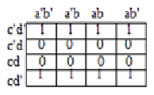



Example of 4 input K-map
d’: c’d’:
(a XNOR b XNOR c XNOR d)’ a’b’ + ab =a XNOR b

Slide 9

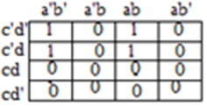


Example of 4 input K-map (continued)
a’b’ + ab + c’d a’b’c’+abc= c(a’b’+ab)= =c (a XNOR b)
(a XOR b XOR c XOR d)+ bd (a XOR b XOR c XOR d)’(a+b+c+d)

Slide 10
Sum of Product/ Product of Sum
Minterms: Minterms are the fundamental part of Boolean algebra. Minterm is the product of N literals where each literal occurs exactly once. Minterm is represented by m. The output for the minterm functions is 1.
Maxterms: Maxterm is a fundamental part of Boolean algebra. Maxterms are the sum of various distinct literals in which each literal occurs exactly once. Maxter is represented M. The output result of the maxterm function is 0.
SOP uses minterms to create a Boolean expression which is product of Boolean variables whereas POS uses maxterms to create a Boolean expression which is sum of Boolean variables.

Slide 11
Example of minterm
abc+ a’bc’+ de:
In this example abc, “a’bc’ and de are mintems
ABCD+ FGH +HYT’
In this example ABCD, FGH and HYT’ are minterms.
(a+b)(e+f):
In this example a+b and e+f are Maxterms
(yazd+abc’+de)(a+b’)(g’+h’):
In this example yazd, a+b’ and g’+h’ are Maxterms

Slide 12
Don’t Care (x)
“Don't care” may also refer to an unknown value in a multi-valued logic system, in which case it may also be called an X value or don't know.
The "Don't care" condition says that we can use the blank cells of a K-map to make a group of the variables. To make a group of cells, we can use the "don't care" cells as either 0 or 1, and if required, we can also ignore that cell. We mainly use the "don't care" cell to make a large group of cells.
Don't Care cell can be represented by a cross(X) or minus(-) or phi(Φ) in K-Maps representing.

Slide 13
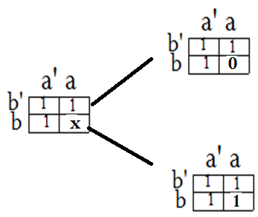
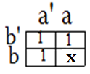
Examples of Don’t Cares
We have two choices
Which one is a better choice?
Why?

Slide 14
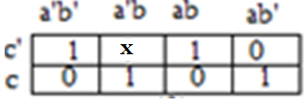
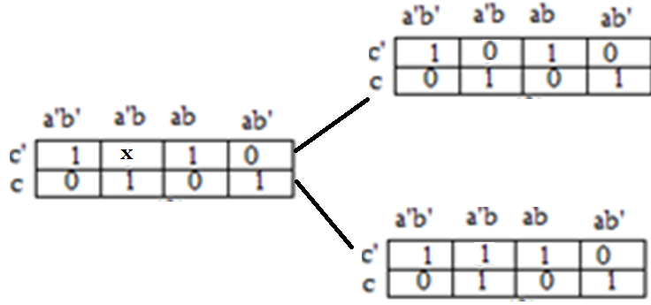
Examples of Don’t Care (continued)
We have two choices:
Which one do you chose?

Slide 15
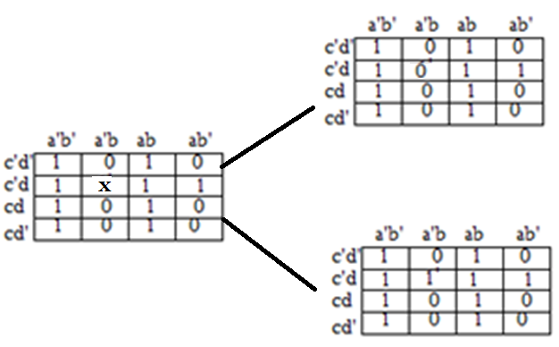
Examples of Don’t Care (continued)
What is the better choice?

Slide 16
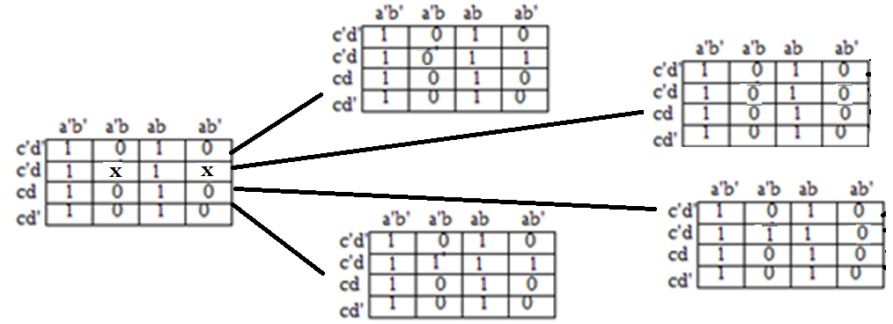
Examples of Don’t Care (continued)

